Slide 1
Machine Learning models with Natural Language Processing as a usable online tool for fake news detection
2467273S

Slide 2

Motivation
Fake News spread all over the Internet
Twitter changing policies
Human accuracy – 54%
Trove of literature available online about similar models, but no tools available

Slide 3
Requirements/Goals
Must Have:
Acquisition of a large dataset
Two ML models using NLP
Better than human performance (54%) for model prediction
Should Have:
Web Application as the tool
Tool accessible to any online user
Could Have
User ability to choose model
Multiple feature engineering

Slide 4
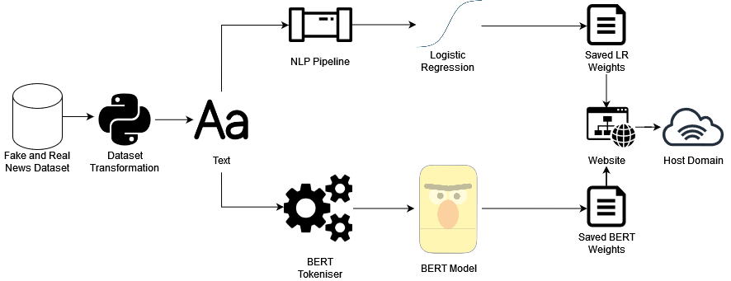
Design
Dataset analysis
Information extraction
Text transformation
Model training
Web application development
Online domain

Slide 5
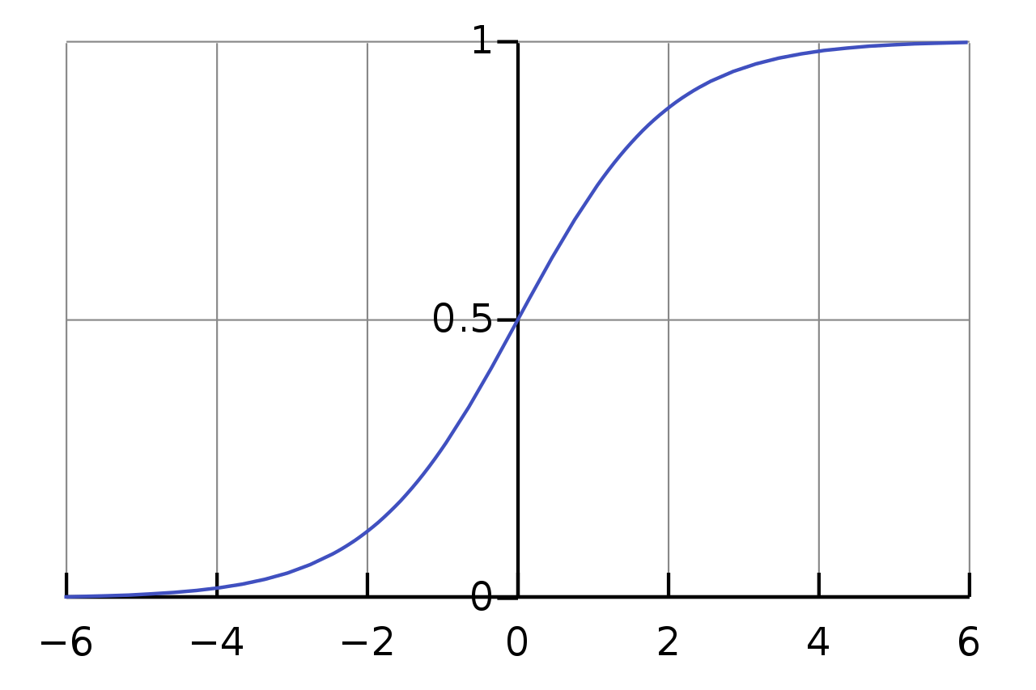
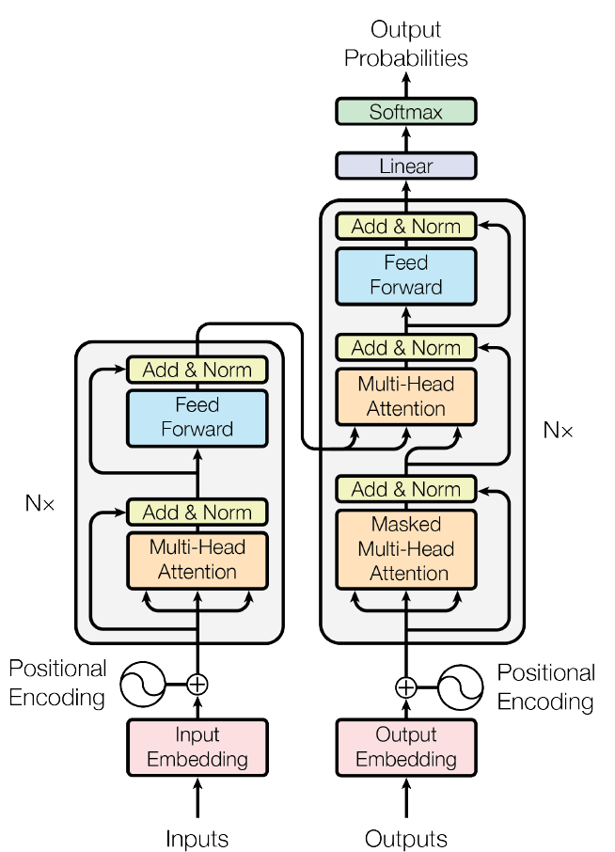
Two Machine Learning Models
Logistic Regression
BERT

Slide 6

Demonstration

Slide 7
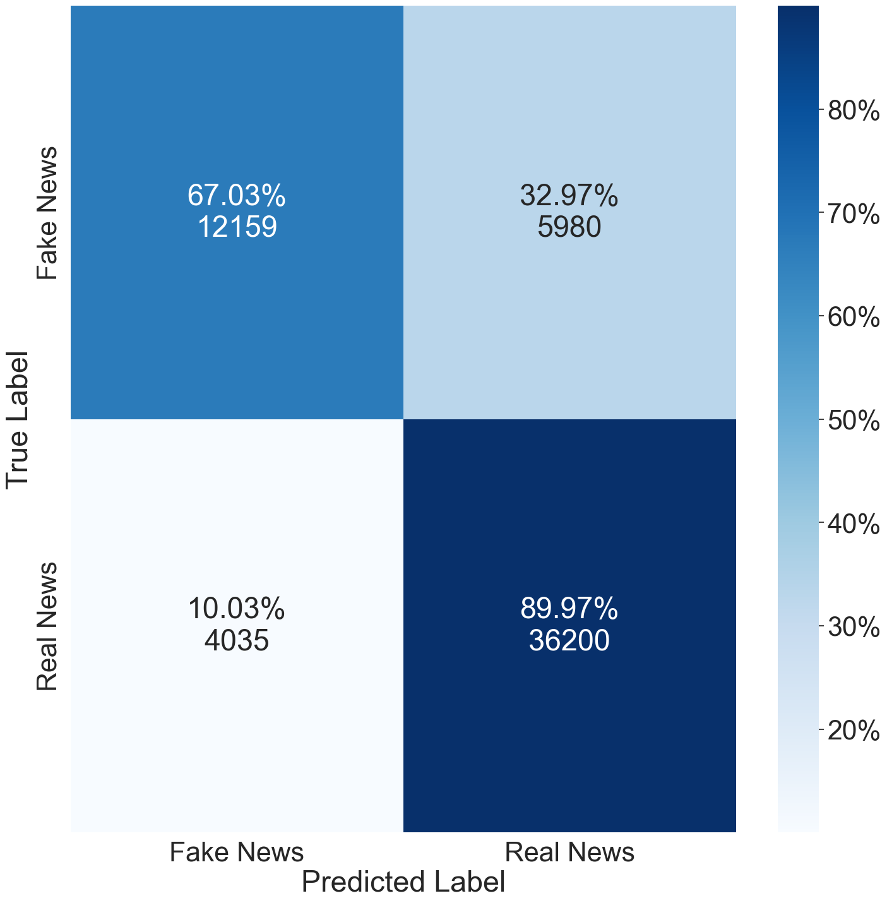
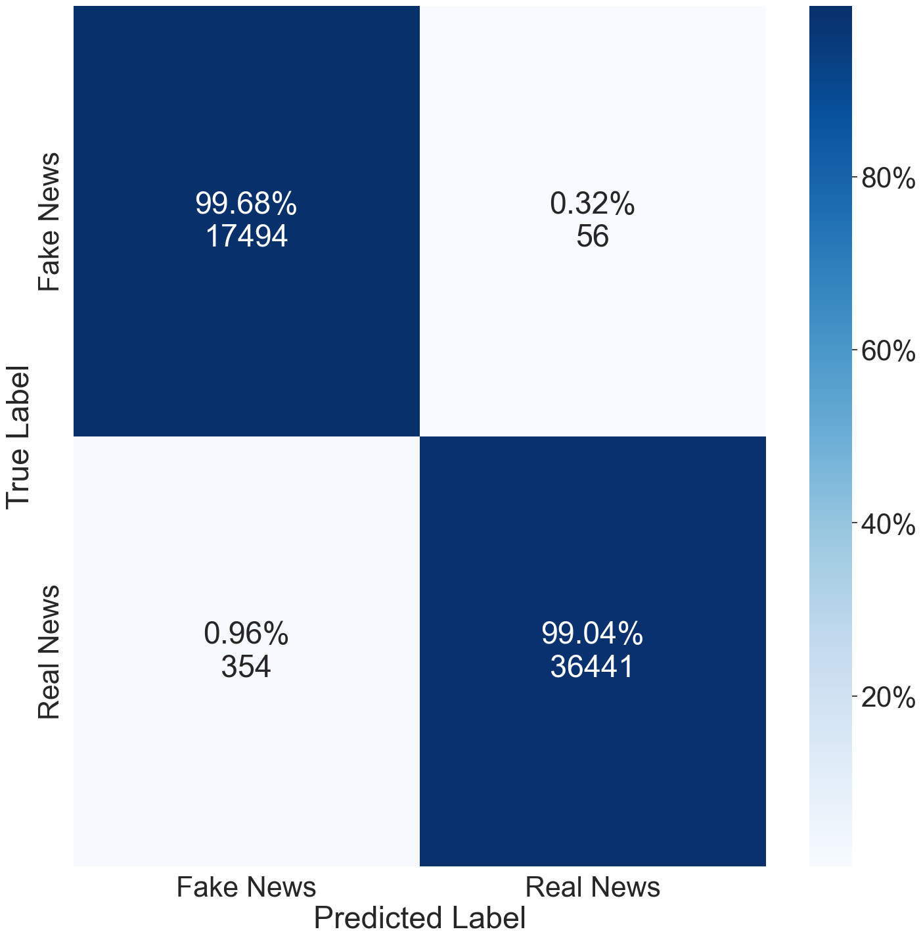
Evaluation
Logistic Regression: 82.6% F1
BERT: 99.4% F1

Slide 8
Further Improvements
Include multilingual processing
Fix skewed confusion matrix
Reduce over-fitting:
Include more diversity of Tweets
Include a broader time period of the political landscape
Standardise dataset for phrase appearance in different classes
Introduce continuous training

Slide 9
Conclusion
Impressive scores for the dataset
Generalisability could be improved
Tool available online: http://fakenewsuofg.pythonanywhere.com/

Slide 10
Thank you for your attention!

